Slide 1
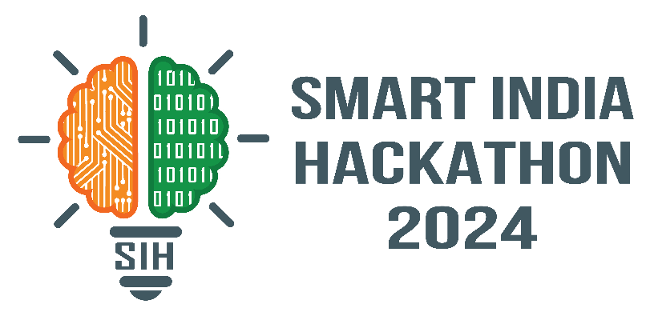
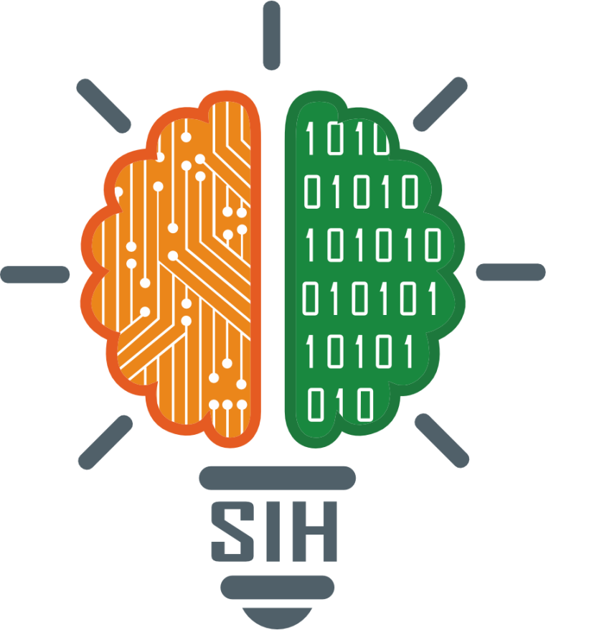
SMART INDIA HACKATHON 2024
Problem Statement ID – SIH1580
Problem Statement Title- Wearable sensor with Artificial Intelligence for prevention of falls in elderly people
Theme- MedTech/BioTech/HealthTech
PS Category- Hardware
Team ID- 21989
Team Name -SparkInnovators

Slide 2
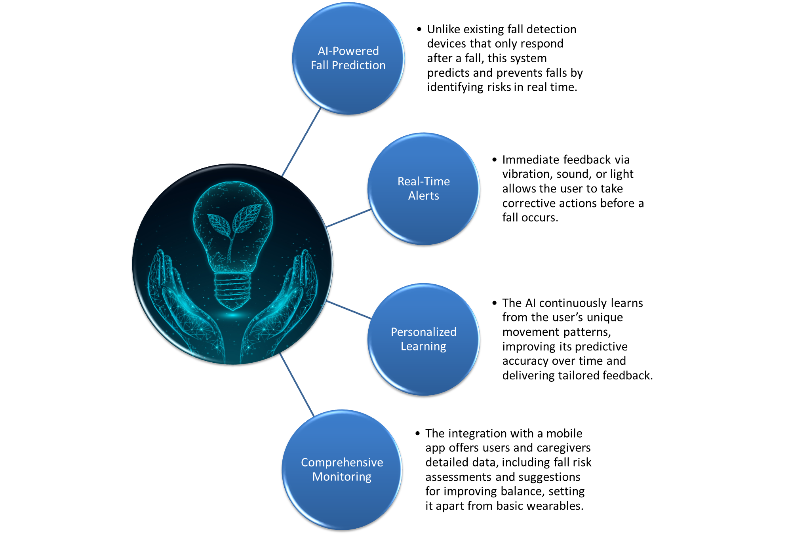
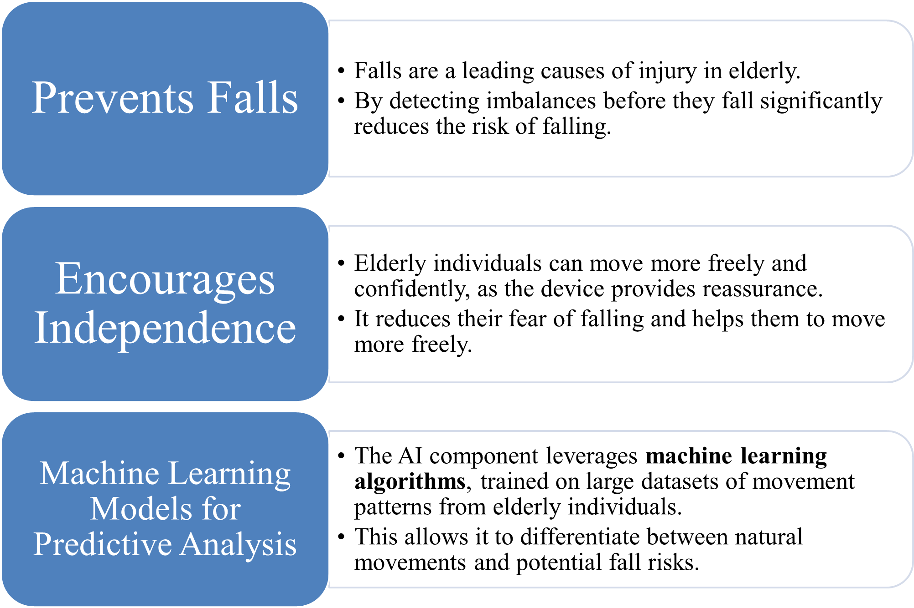
Smart Wearable Watch
SparkInnovators
We propose a Wearable Sensor System with an integrated AI and alert system designed to prevent falls in elderly individuals. The system involves a lightweight, wearable device equipped with motion sensors (accelerometers, gyroscopes) that continuously monitors a person’s movement. When a risk is detected, the device provides real-time feedback through AI models, allowing the user to correct their posture or balance.
Addressing the Problem

Slide 3
TECHNICAL APPROACH
SparkInnovators
Machine Learning Implications
Hardware Implications
Data Aquisition
Obtaining Dataset from reliable Sources
Our Dataset will be 4*m matrix where m is number of Parameters and 4 is number of timesteps.
Model Training
We use CNN architecture with LSTM's in this project.
Integrating with micro controllers
Testing
On the Input data we'll check the performance of our model and do the hyperparameter optimization etc. for increasing the model performance.
For this we'll integrate our microcontroller with our NN model.
We'll use TinyML library which will help programming microcontroller using NN model.
Wristband Form Factor
The wearable sensor will be embedded into a compact wristband designed for elderly users.
Sensor Integration
Power Management
Microcontroller Unit
A low-power microcontroller (e.g., ESP32 or Arduino Nano) will process the sensor data in real-time, enabling the execution of AI-based algorithms directly on the device or by transmitting data to a connected smartphone for advanced processing.
The wristband will have a rechargeable battery with efficient power management to ensure long-lasting battery life (e.g., 24-48 hours) for continuous monitoring without frequent recharging.
BNO055 Sensor: Integrated for real-time 3D orientation, accelerometer, and gyroscope data.
AD8232 ECG Sensor: Monitors heart rate, providing additional health metrics.
We are using LSTM because our data is time-stamped, which helps in understanding patterns over time. CNN is used since the data will be in arrays, allowing it to easily spot patterns in the data.

Slide 4
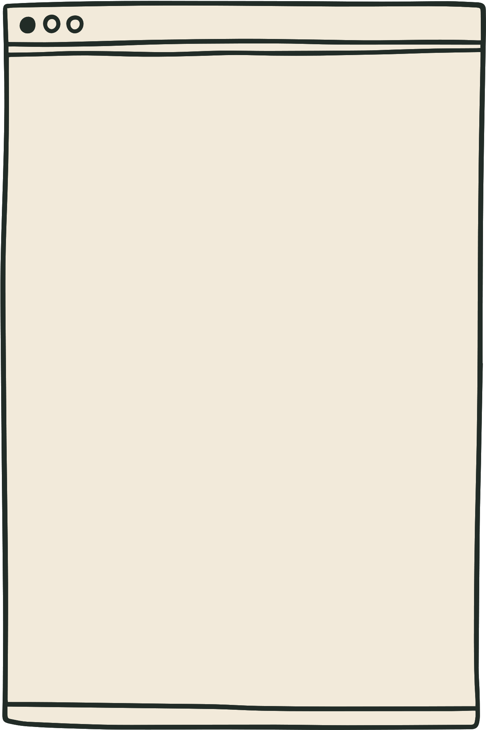

FEASIBILITY AND VIABILITY
SparkInnovators
Feasibility Analysis of the Product
Risk Assessment And Mitigation
Accuracy of Fall Detection: We need to train AI model to detect if a person is falling or not. If a sudden movement or jerk is misclassified as fall it might cause uneccessary panic.
Continuously refining the model and modifying the parameters at regular intervals will help us prevent this. Implement adaptive learning to improve accuracy over time.
Technological feasibility
Operational feasibility
Financial feasibility
Motion sensors are widely available, these can measure body movements with high precision.
Low-power microcontrollers are suitable for wearable devices and can efficiently process real-time data from sensors.
Machine learning models for analyzing movement patterns and detecting deviations are mature and can be easily adapted to predict falls.
The device is lightweight, comfortable, and non-intrusive, allowing elderly users to wear it all day without discomfort.
Simple alerts (vibration, sound, visual) are easy to understand and respond to, requiring minimal training for users and caregivers.
Readily available sensors and components ensure scalable production. Technical support will assist with setup and troubleshooting.
The device uses affordable sensors (accelerometers, gyroscopes) and low-cost microcontrollers (e.g., ESP32), keeping manufacturing expenses down.
The lightweight design and simple hardware result in a cost-effective product.
The components are widely available, allowing the system to be produced at scale, reducing per-unit costs with higher production volumes.
User Adoption: The elders might be resistant to wear a smartwatch with sensors due to unfamiliarity with technology or general resistance.
Design the wearable to be lightweight, comfortable, and visually discreet. Ensure the means to interact with the watch or the user interface is simple enough.
Data Privacy and Security: Collecting and transmitting personal health data could pose risks related to privacy and data breaches.
Ensure secure communication mechanisms between the devise and the data channels so that the data leakage and breaches can be minimized.
Competition and Market Saturation: The market for wearable health devices is competitive, and similar products may already exist, making it difficult to differentiate.
Focusing on unique selling points such as AI powered fall detection and alerting system. Integration with caregiver support. Focusing the marketing on these factors along with the utility and affordability of the product.

Slide 5
IMPACT AND BENEFITS
SparkInnovators
Potential Impact on Target Audience :
Benefits of the Solution :
Environmental Benefits:
E
Social
Benefits:
Economic Benefits:
Enhanced Safety:
Real-time fall detection and health monitoring provide a safety net for elderly individuals, improving their well-being.
Health Monitoring:
The addition of heart rate monitoring using the ECG sensor enables early detection of abnormal health conditions.
Reduced Caregiver Burden:
Family members and caregivers can be less stressed about constantly monitoring the elderly.
Enhanced Quality of Life:
The elderly can experience feeling secure and confident which helps reduce isolation and mental health issues .
Cost-Effective Healthcare Monitoring:
Can reduce hospital visits, emergency care, and rehabilitation costs
.
Affordable Solution:
Leveraging TinyML and microcontrollers like ESP32 or Arduino helps in building a low-cost device, making it accessible to a larger population.
Low Energy Consumption: The use of low-power microcontrollers and TinyML reduces energy consumption, contributing to a more environmentally sustainable solution.
Wearable Longevity: The wristband’s durable design and efficient power use which reducing electronic waste over time .
Wrist Watch for Fall Detection
Ease of Use and Comfort:
The wristband form factor makes the solution easy for elderly users to wear and interact with.
Increased Independence:
Elderly people can maintain a higher degree of independence without constantly worrying about their safety.

Slide 6
RESEARCH AND REFERENCES
SparkInnovators
https://www.frontiersin.org/journals/robotics-and-ai/articles/10.3389/frobt.2020.00071/full
https://www.researchgate.net/publication/333003247_Fall_detection_algorithm_based_on_accelerometer_and_gyroscope_sensor_data_using_Recurrent_Neural_Networks
https://eloquentarduino.github.io/2020/11/tinyml-on-arduino-and-stm32-cnn-convolutional-neural-network-example/#tochow-to-run-a-cnn-on-arduino-and-stm32-boards-with-eloquenttinyml

